Slide 1
A simulated
Mo
del:
the cartwheel galaxy

Slide 2
Table of Contents

Slide 3
Introduction (pgs. 5 - 12)
Purpose (pg. 6)
Observation (pg. 7)
Theory (pg. 8)
Computational Theory (pg. 9)
Galactic Model Exploitation (pg. 10)
Plummer Distribution (pg. 11)
Key Aspects of the Model (pg. 12)
N-Body (pgs. 13 – 19)
Code Structure (pg. 14)
Leap Frog – Verlet Method (pg. 14)
Tree Code (pg. 14)
Containments (pgs. 15 – 19)
Cartwheel Galactic Model (ditto)
Radial Distribution (pg. 16)
Epicyclic Approximation (pg. 17 & 18)
Velocity Dispersion (pg. 19)

Slide 4
Continuing the N-Body Code (pgs. 20– 24)
Adiabatic Compression (pg. 21)
An Adiabatic Theory (pg. 22 – 24)
Axisymmetric Rings (pg. )
Pseudo-Axisymmetric Rings (pg. )
Bulge of Disc (pgs. )
Radial Significance (pg. )
Mass Definition (pg. )
Spin/Velocity (pg. )
Oscillation (pg. )
Interpretation of Forces (pg. )
Animations/Images (pg. 27 to 33)
References (pg. 34)
Credits (pg. 35)

Slide 5
Introduction

Slide 6
Purpose
To find the time independent ring galaxy formation by observing the perturbed disk galaxy. Compare the results with the ”Cartwheel Galaxy”.

Slide 7
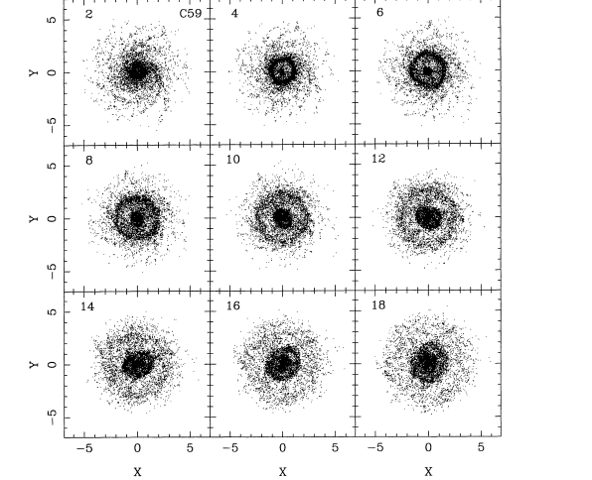
Observation
Diameter: 45 kpc
Radius: 22.5 kpc
A Simulated Model: The Cartwheel Galaxy - Introduction

Slide 8
Theory

Slide 9
Computational Theory

Slide 10
Galactic Model Exploitation
Model Representation
Plummer (PL) -
Kuzmin and Toomre (KT) -
Galaxy Type
Disc – KT – 8,000 Stars
Halo – PL – 30,000 Stars -
Bulge – PL - 2,000 Stars – 1/3 * Mass
Companion – PL – 4,000 Stars – 2/3 * Mass

Slide 11
Plummer distribution
The Plummer Distribution is modeled different ways for different galaxies as the following given functions of r for the Halo, Companion, and Bulge are , ,
, respectively. Where the Halo ‘b’ term is equivalent to b=5, b_{D}=1, b_{B}=0.375 according to Athanassoula et al. using low value parameters and M is the Mass per respective model, while ‘b’ Is a scale length. This model can be used for various types of galaxies or randomized spherical point distributions.

Slide 12
Key aspects of the model
Mass of First and Second Companion Must be Defined (MBD)
Velocity Dispersion of First and Second Companion MBD
Amplitude, Shape, Expansion Velocities, Ring Formation over time, and lifetime of ring formation must be explored (MBE)
Formation and Evolution of Spokes MBE
Use a relatively small mass on the order of 0.02 * M to 0.2 * M for the secondary companion
Barred Galaxies and the Unbarred Galaxies MBE
Initial Asymmetrical Pseudo-ring MBD
Asymmetrical Post-Pseudo-ring MBE

Slide 13
N-Body

Slide 14
Code Structure
Leap Frog – Verlet
As in HW, the main algorithm to perform the simulation
Tree Code
Octree at beginning of the simulation
Get F/A on each particle
Maintain tree when particle moves (delete leaf, then reinsert the particle)
A Simulated Model: The Cartwheel Galaxy - N-Body

Slide 15
Containments
Physical Interpretation/Theory
Cartwheel Galactic Model
Radial Distribution
Vertical Distribution
Mass Distribution
Velocity Dispersion
Surface Disc Density
Adiabatic Compression
Axisymmetric Rings
Psuedo—Axisymmetric Rings
Bulge of Disc
Radial Significance
Mass Definition
Spin/Velocity
Oscillation
Interpretation of Forces

Slide 16
Radial Distribution
The radial distribution was mentioned in the Plummer Sphere slide for the bulge, halo, and companion; however, for the disc we used the Galactic Package for one set of distributed points and a Plummer Sphere initialization set using:

Slide 17
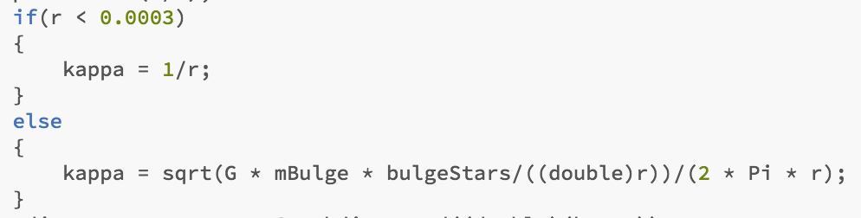
Epicyclic Approximation
Taking can be approximated by at close range,
and at nearly large radii, (Binney and Tremaine 2008). Setting the near approximate frequency; however, our model used a different approach.
The velocity dispersion is based off the epicyclic approximation using a series of if statements in the code and a generalization that at small enough radii, the epicyclical frequency is proportional to 1/r, and the rest is equivalent to the exact in our model, but can be even more specified approximately.

Slide 18
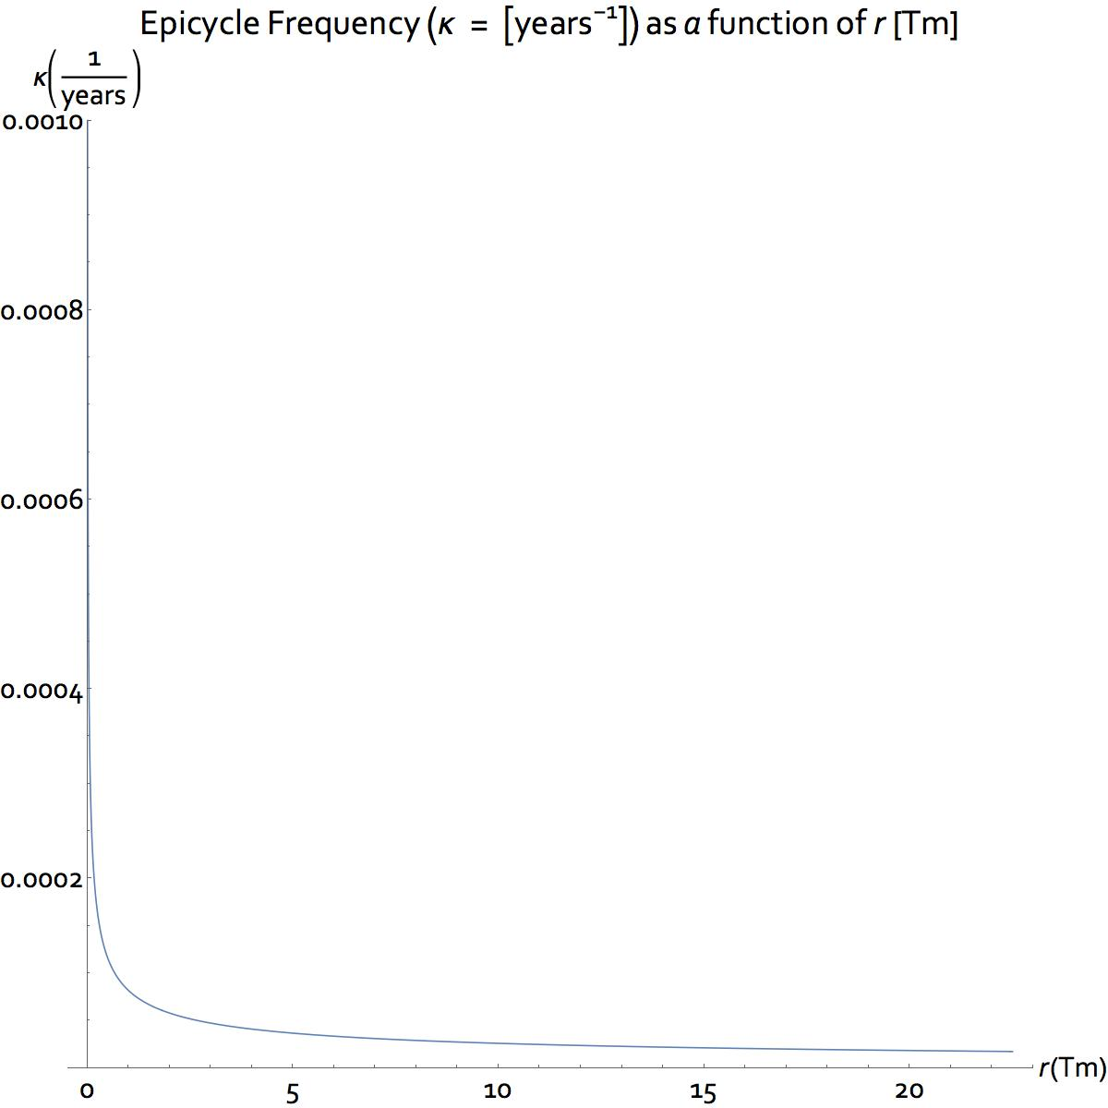
Epicyclic Approximation
Here is a graph of the exact Epicycle Frequency and
It is plotted using G in [Tm/(years² * M_Solar)], where κ is in [years⁻¹].
The graph illustrates a very linear approximate κ
that at very small radii is approximately 1 divided by a very small number, so no matter where you are in the distribution you will find a very large number; therefore it is accepted in various literature as equivalent to the actual, and is simple to compute.

Slide 19
Velocity Dispersion
There are two major concerns about the circular velocity for any rotating body:
1.
2.
3.
The velocity dispersion is taken by the Q-parameter that we set to 1.3; as that felt right for our distribution; however, any of the given Q-parameter values could be used according to Athanssoula et al.. The Q-parameter is equal to,
,where , G, , and are
the velocity dispersion, gravitational consant, radial distribution, and the epicycle frequency, respectively. Q is independent on the radius, and therefore can better determine a radial velocity dispersion that is not weighted along ’r’. Solving for the velocity dispersion one obtains numeral ’3’ to the left.

Slide 20
Constricting the N-Body Code

Slide 21
Adiabatic Compression
To make sure that the potential energy is consistent with the initial total potential energy of the system, a concept called Adiabatic Compression, which allows for the energy and the angular momentum of any star to be conserved as the secondary companion galaxy tugs on the primary companion galaxy and causes the primary companion galaxy to first contract and then rebound.
To do so, we include a method of finding a potential energy for a given star in the distribution to equal an initial given potential from our initial condition, which can relate the current potential energy of the star to an initial action set. Where the actions are defined as the parameters of a given star such as the potential energy, the angular momentum, the velocity, the radius, and it’s energy.

Slide 22
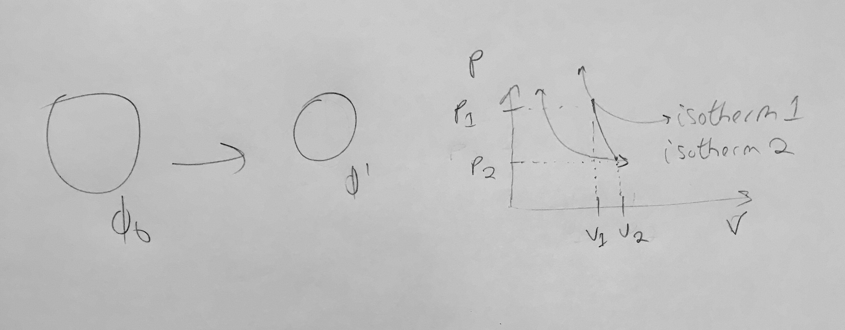
An Adiabatic Theory
If we start with φ₀, then we must maintain a φ₀ overtime. If , .
then the initial starting potential is given above. This is the
total potential of our initial system. , where is the new acceleration of the halo that will be added to the halo particle accelerations to give physical meaning, where …

Slide 23
An Adiabatic Theory: Continued…
add r_{Hp} to distance to hal particle as it has to travel by this much more,
but do this by adding an acceleration to the particle instead by , where is the new additional halo acceleration based off keeping the potential constant.
. The method for implementation on this theory is to use the adiabatic compression
constant, , and the max potential the simulated total body is given by this constant. There is a potential adiabatic theory that uses a ρ function that generates a new model for the total potential of the simulated body; however, it was hard for us to implement this model into a coded model with limited time. The theory is described above in the Adiabatic Compression slide.

Slide 24
An Adiabatic Theory: Continued…
the halo has to counteract the bulge and companion discs . Calculate . The idea
behind this is to add up all the potentials and set them equal to the initial potential energy that will give you a constant potential energy to match over time. First calculate the initial potential and then calculate
as t evolves. Knowing this, you can calculate a new force for the halo using
, which you can add to all the halo particles to produce a sophisticated model of remodeling the galaxy to include adiabatic compression. The reason why this should work is to imagine that we do not know what the dark matter/dark energy is made up anyways. Thus, include a fluid incompressible term that will generate a acceleration that will aid in the compression of the entire simulated body.
C
O
N
S
T
A
N
T
C
O
N
S
T
A
N
T
C
O
N
S
T
A
N
T
V
A
R
I
A
B
L
E
C
O
N
S
T
A
N
T

Slide 25
Axisymmetric Rings

Slide 26
Pseudo-Asymmetric Rings

Slide 27
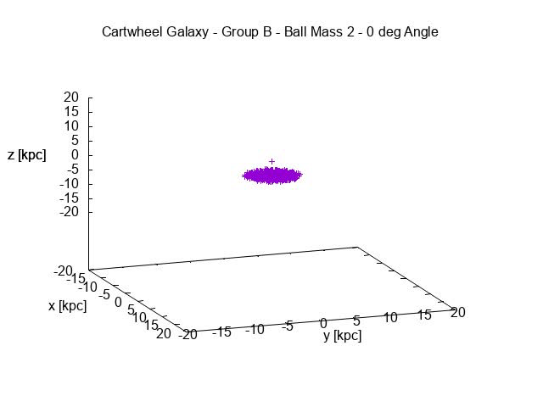
MPEG

Slide 28
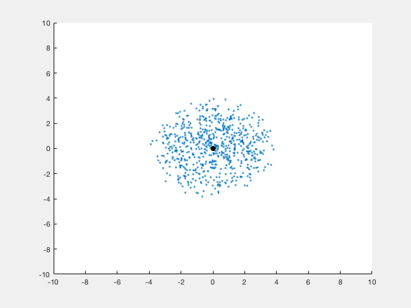
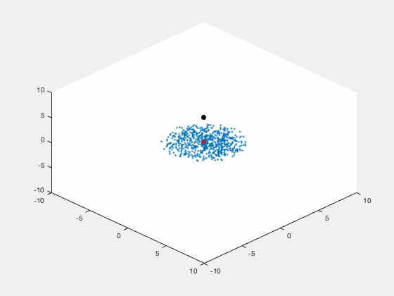
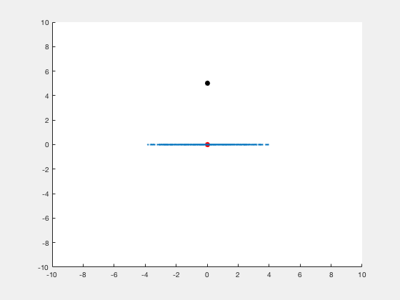
Center Verticle

Slide 29
Center verticle with half mass companion

Slide 30
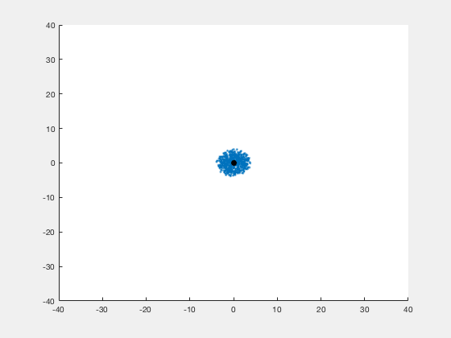
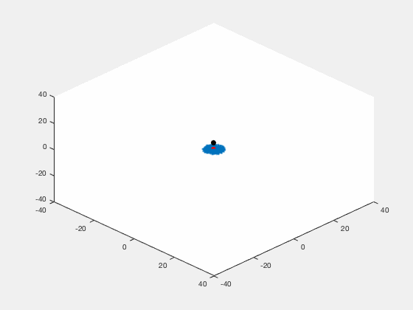
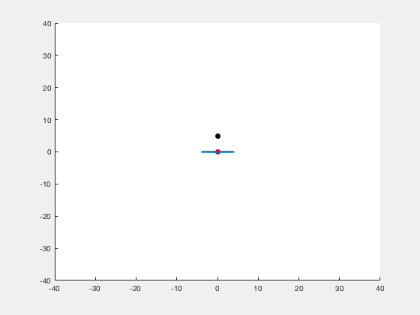
Center Vertical with double mass companion

Slide 31
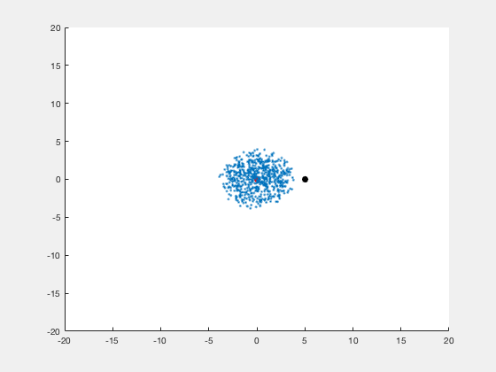
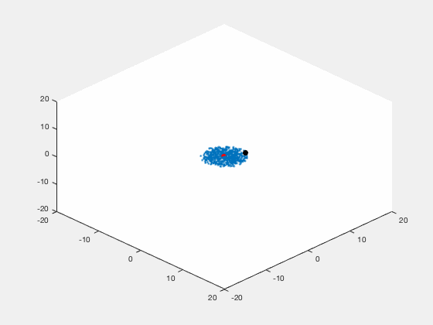

Companion with 45degree shifted

Slide 32

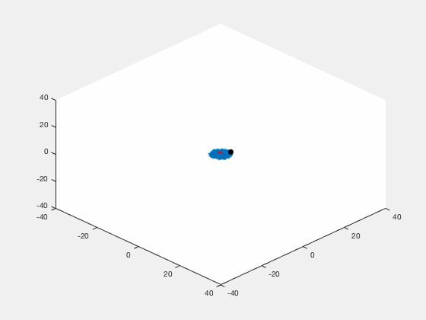
Companion 45degree shifted double-mass

Slide 33

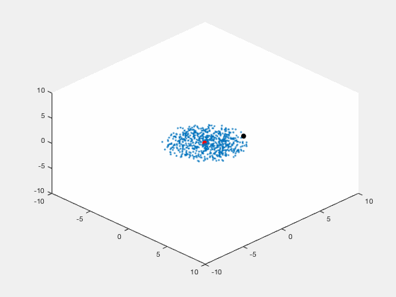
Companion 45degree shifted half-mass

Slide 34
Works cited:
E.Athanassoula, I. Puerari and A. Bosma. Formation of rings in galactic discs by inflating small companions. Mon.Not.R.Astron.Soc, 286,284-302, 1997
Lynds, Roger and Toomre, Alar. On the Interpretation of Ring Galaxy. The Astrophysical Journal, 209: 382 - 388, 1976
A Simulated Model: The Cartwheel Galaxy - References

Slide 35
Credits:
Presentation Manager: Ross Pappas
Co-Presentation Manger: Hongrui Wu
Presentation Editors: Cartwheel B
Lead N-Body Coder(s): Yaoguang Zhai
Co-Lead N-Body Coder(s): William Wylie-Modro
Lead Theoretical Physicist: Ross Pappas
Lead User of Galactic Package: Hongrui Wu
Hypothetic CUDA Developers #1: William Wylie-Modro
Hypothetic CUDA Developers #2: Ross Pappas
Lead Tree-Coder: Yaoguang Zhai
Tree Code Debugger: Wiliam Wylie-Modro
Tree Code Analyzer: Ross Pappas
Key:
Cartwheel B - Hongrui Wu, Ross Pappas, William Wylie-Modro, and Yaoguang Zhai

Slide 36
Thanks for watching !

